Slide 1



adding realities to the State of Our City tool
Reta Giblin
DSBA 6400 Internship
May 3, 2024

Slide 2

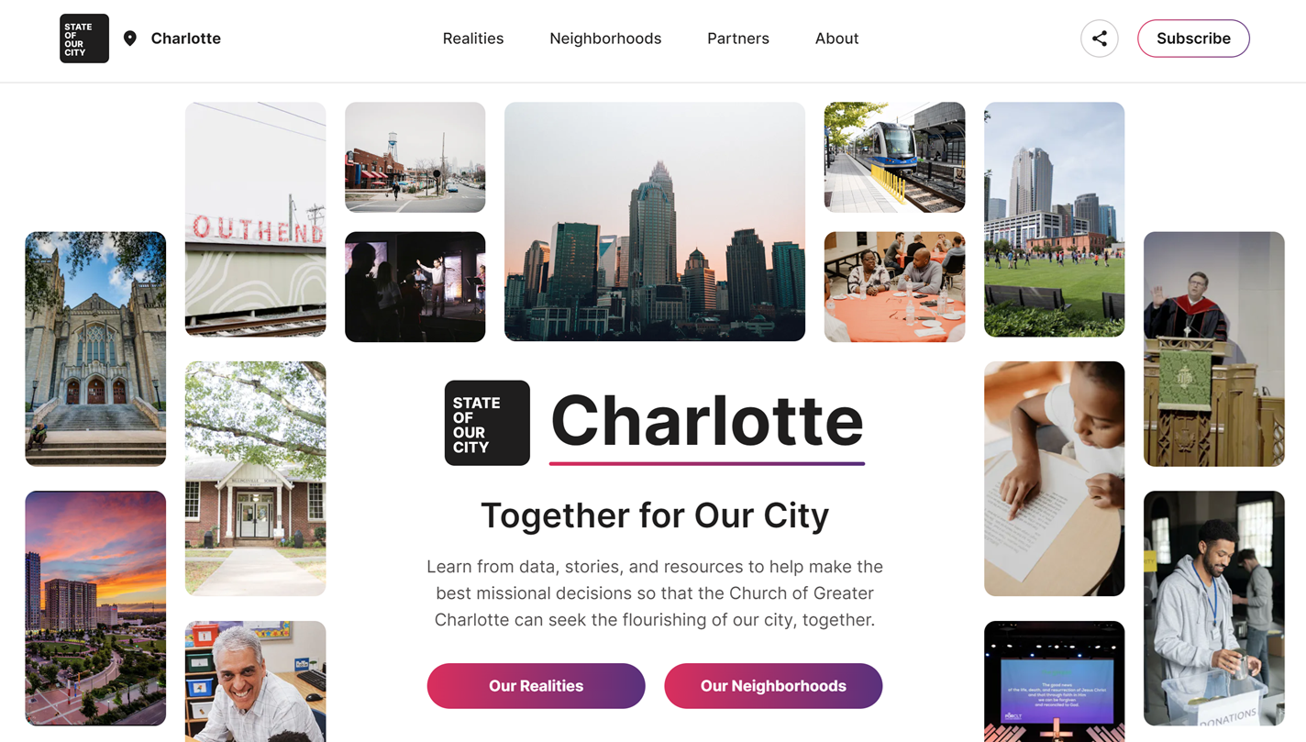
GROWING DEMAND TO EXPAND STATE OF OUR CITY TOOL
State of Our City is a resource to help churches connect with the needs in Charlotte

Slide 3
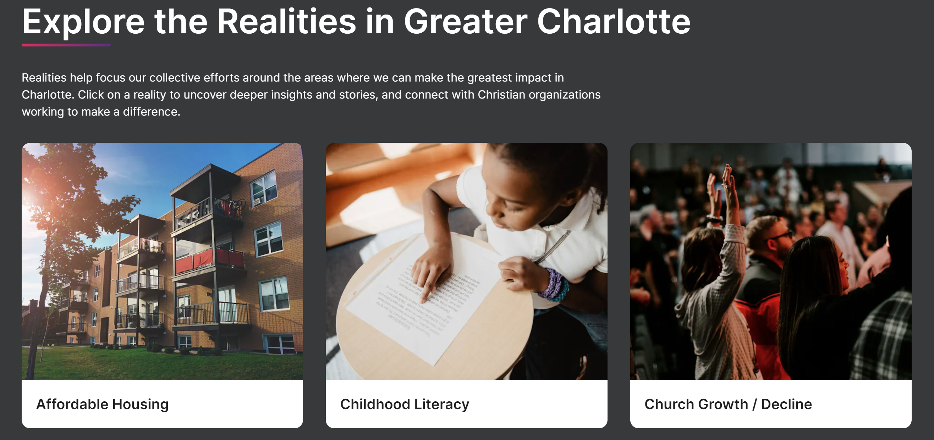


INFORMATION IS A KEY TOOL IN CONNECTING THOSE IN NEED WITH THE RESOUCES

Slide 4

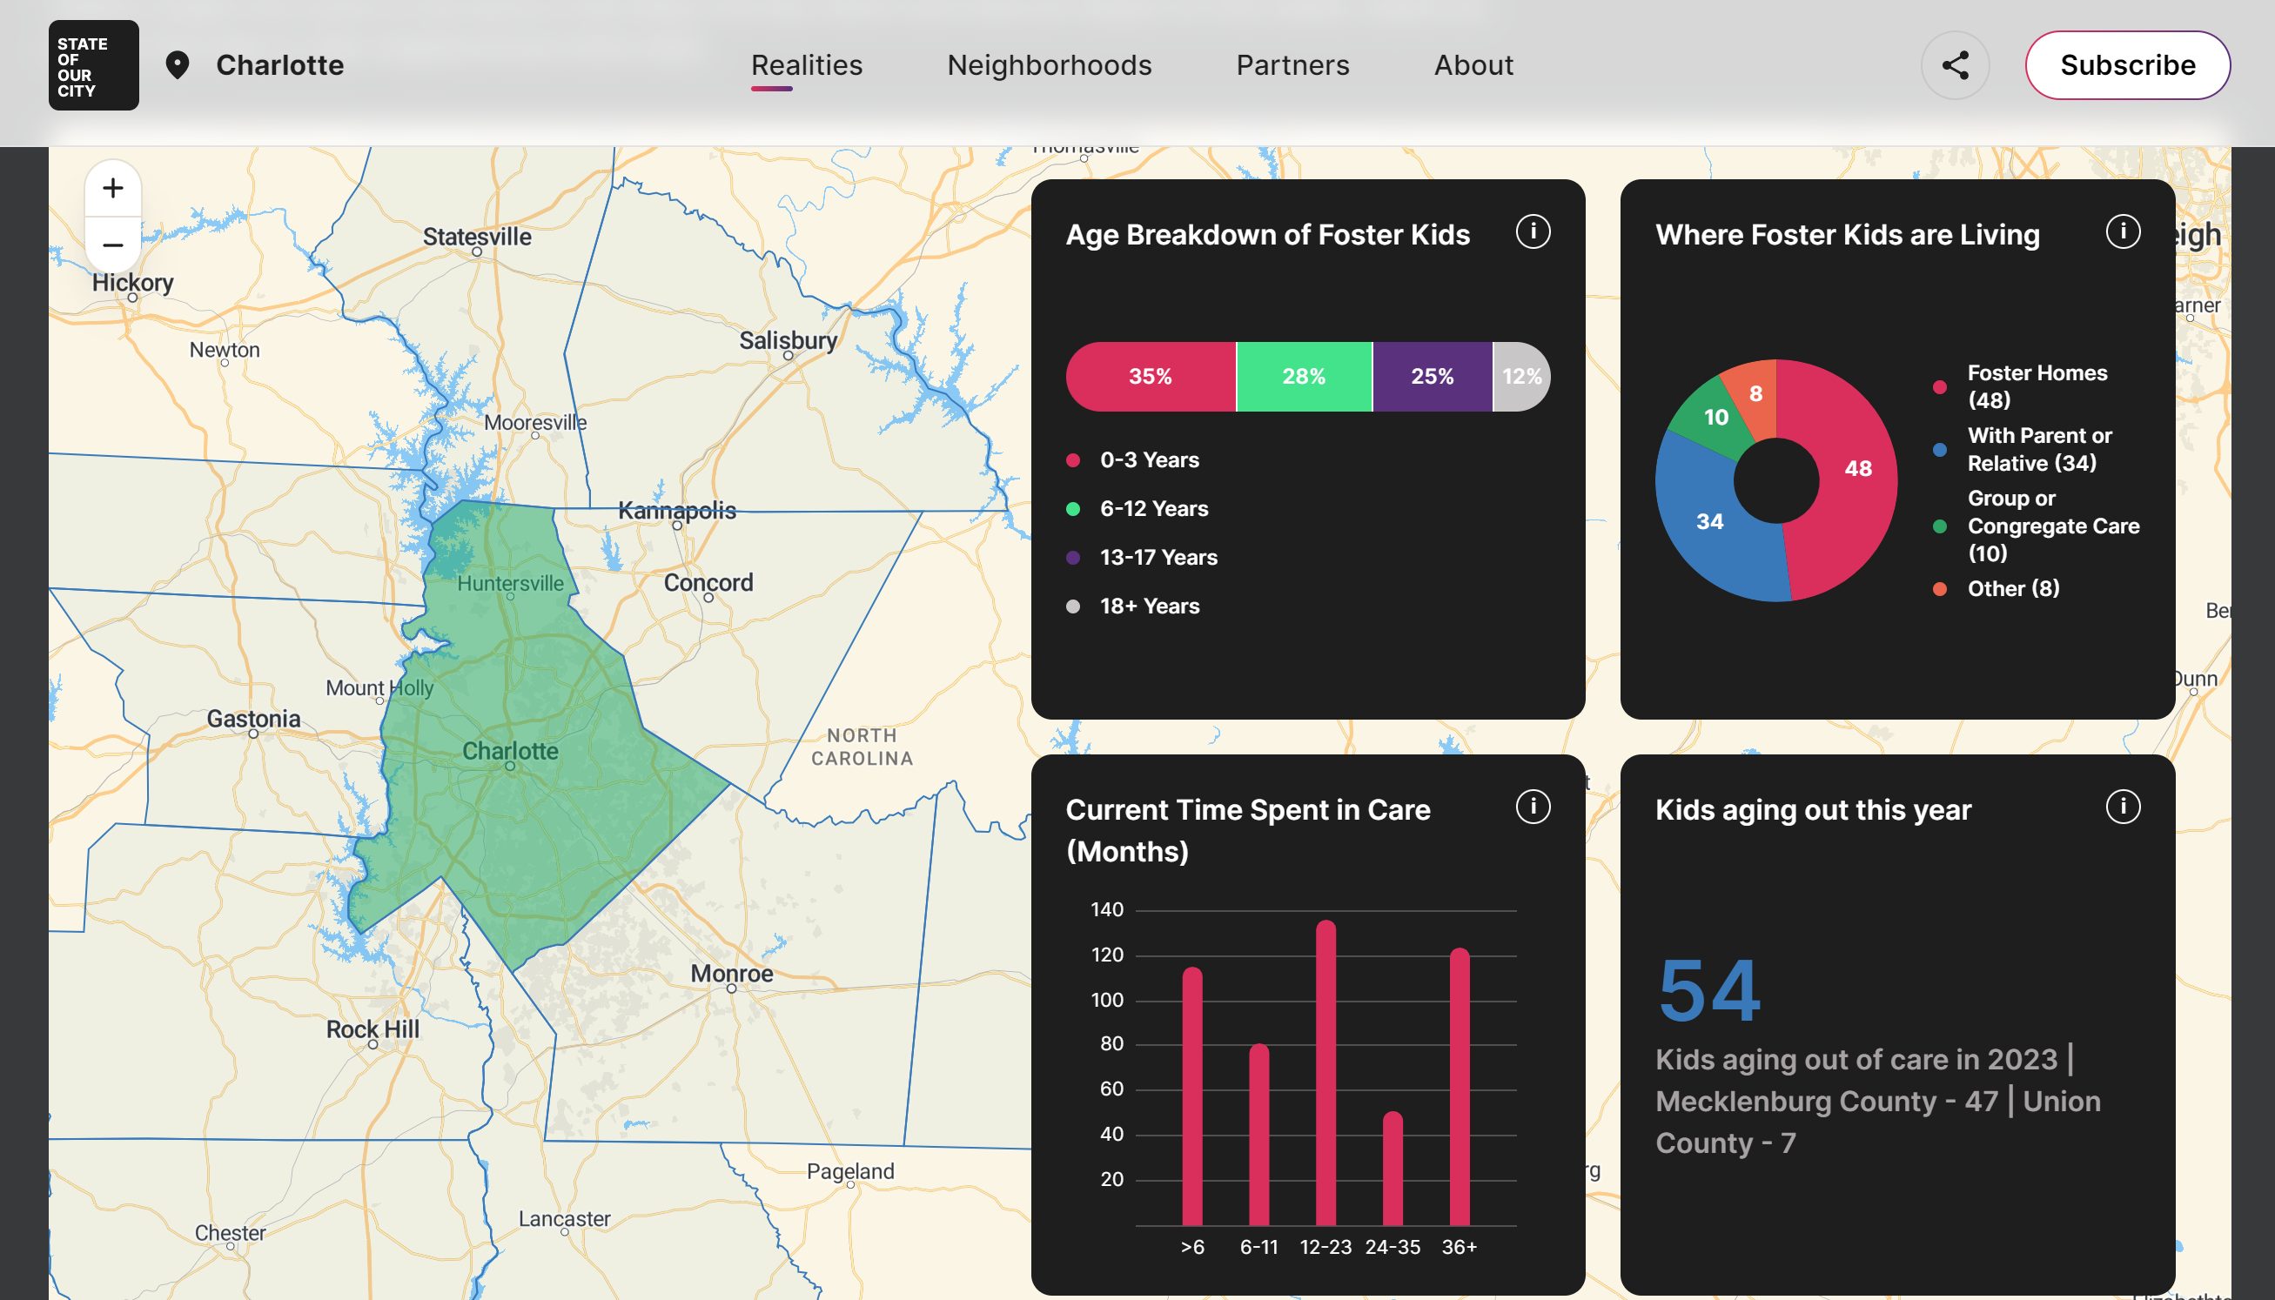
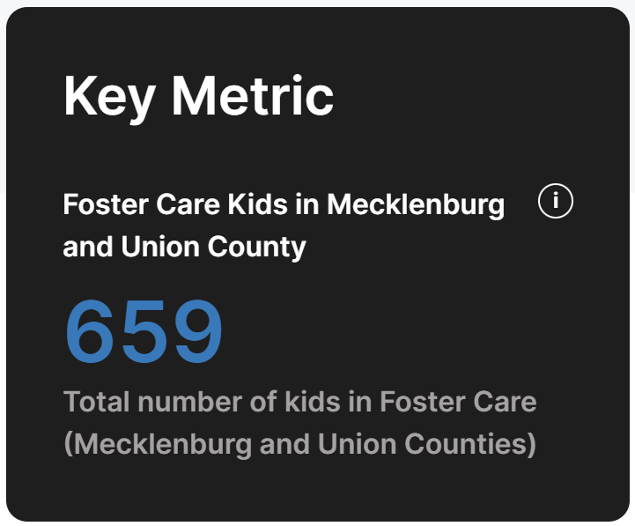
DATA IS A KEY TOOL IN CONNECTING THOSE IN NEED

Slide 5




INTERNSHIP ADDED MORE DATA TO THE STATE OF OUR CITY TOOL
Marriage
Disabilities
Upward Mobility
Marriage
Disabilities
Upward Mobility

Slide 6
Adding a reality is split into steps
Research area
Find and analyze data to SUPPORT
Choose 5 most salient data points
Create visuals

Slide 7


Glance into marriage

Slide 8
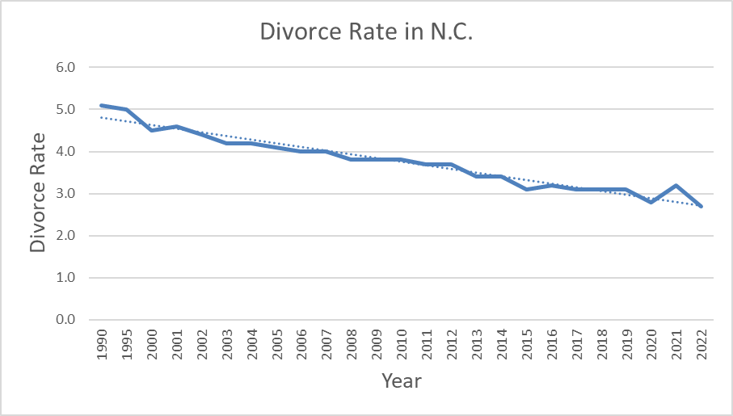
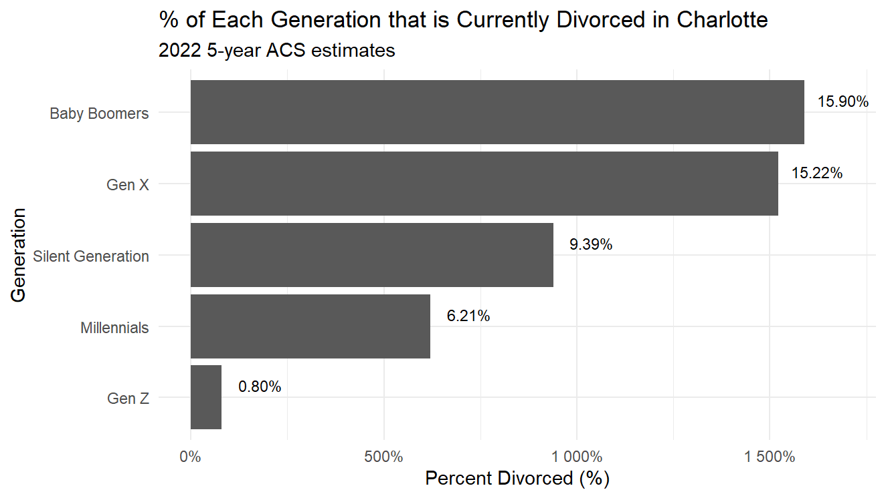
Divorce rate is declining

Slide 9
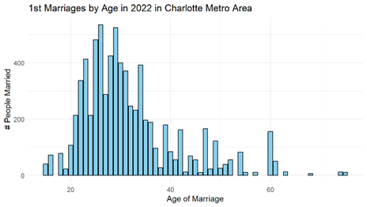
Age of 1st marriage is increasing
Median Age for 1st Marriage in Charlotte is 29

Slide 10
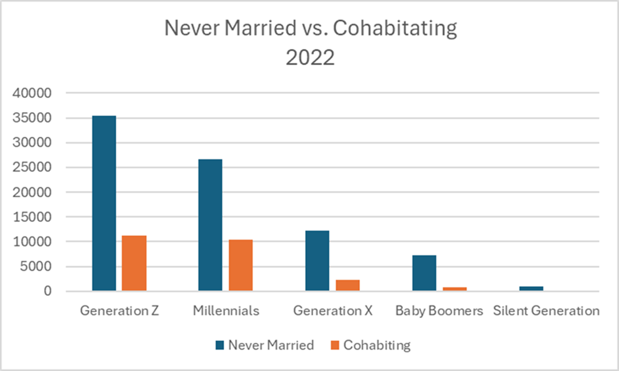
Younger generations cohabitating

Slide 11
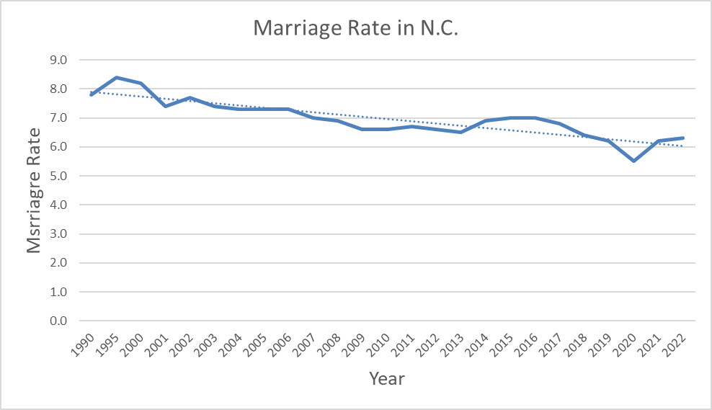
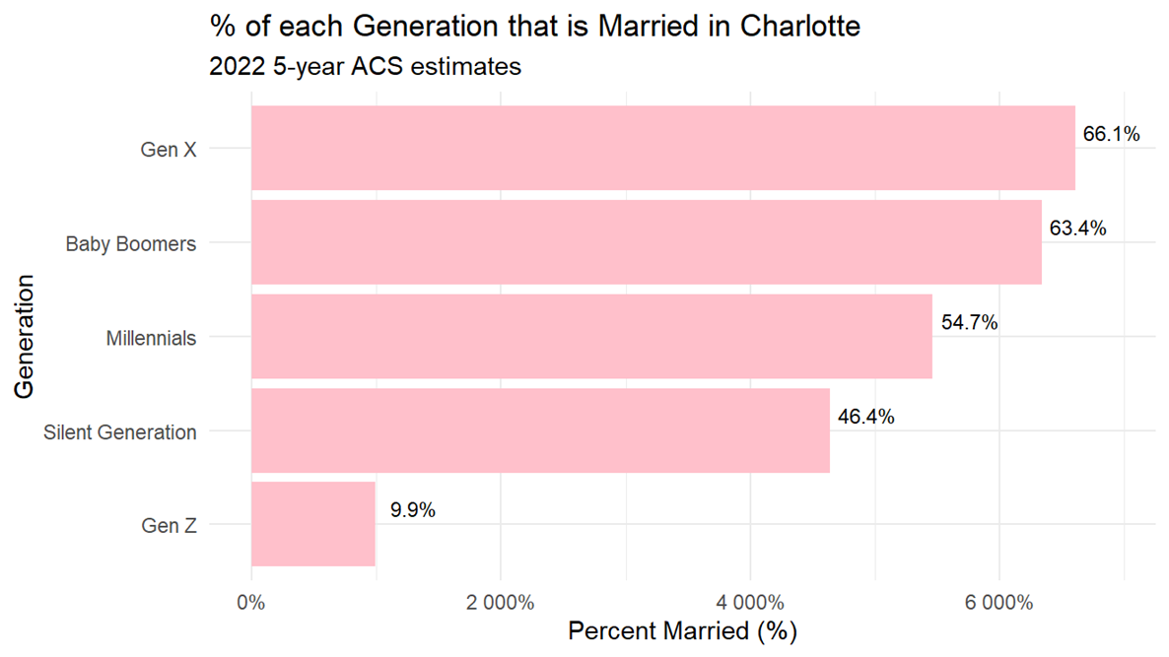
Marriage rate is declining

Slide 12
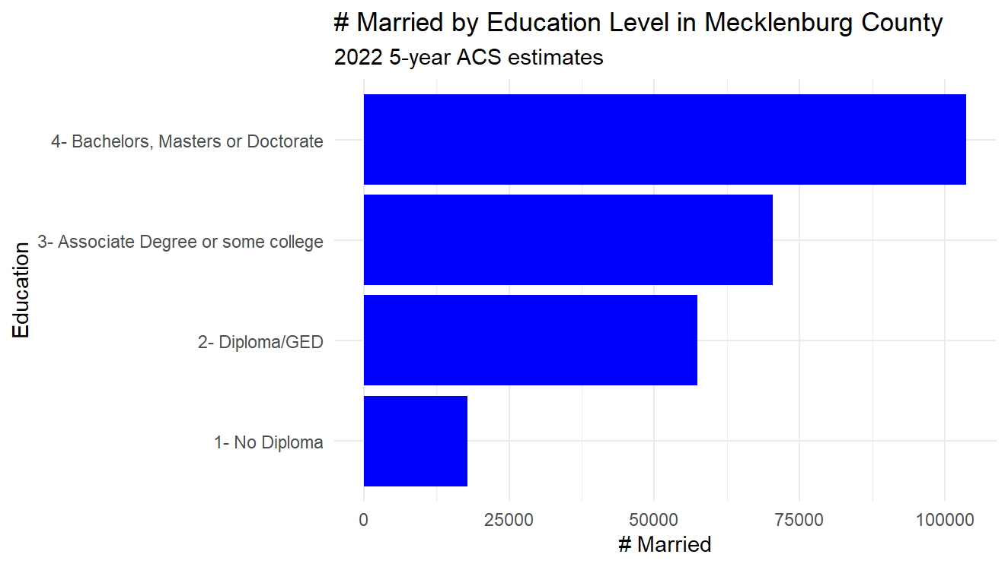
Less educated less likely to marry

Slide 13


Glance into disability

Slide 14
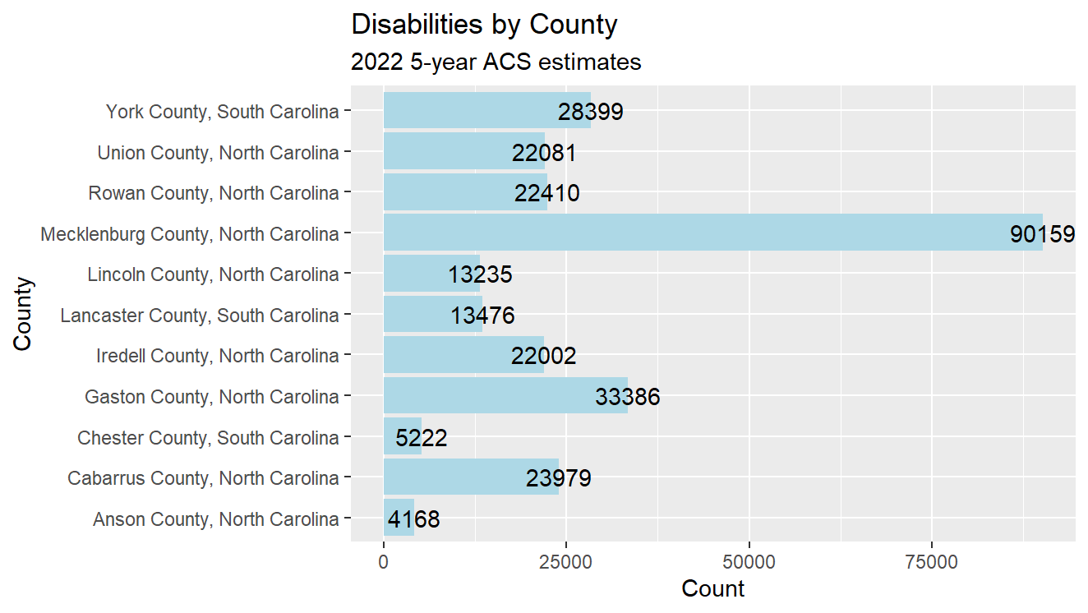
Number of disabilities by county

Slide 15
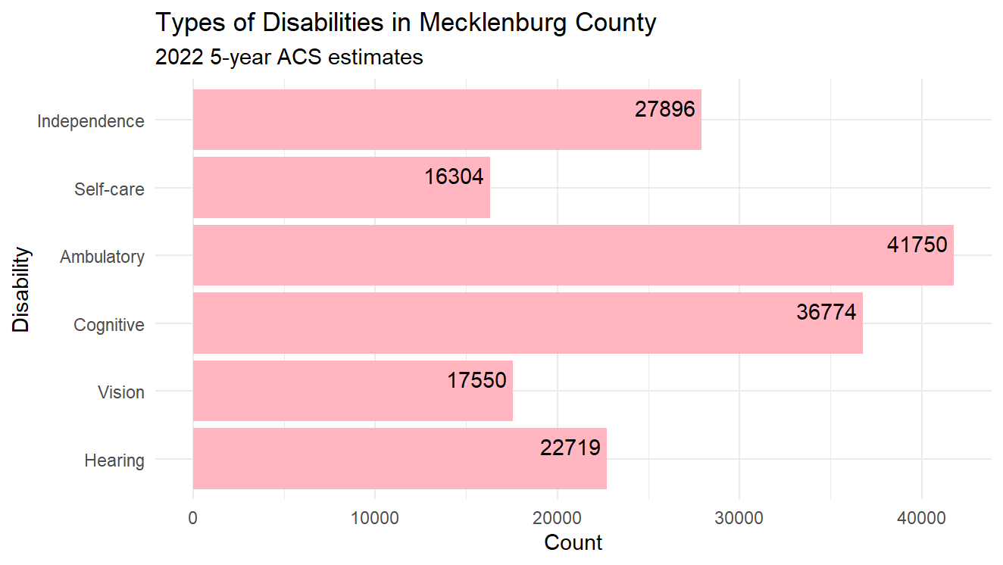
Types of disabilities

Slide 16
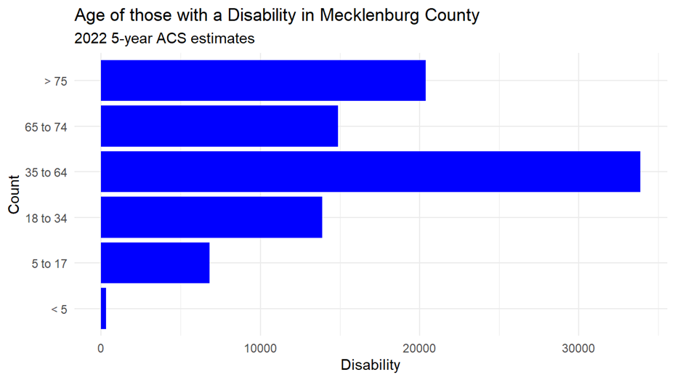
Age of those with a disability

Slide 17
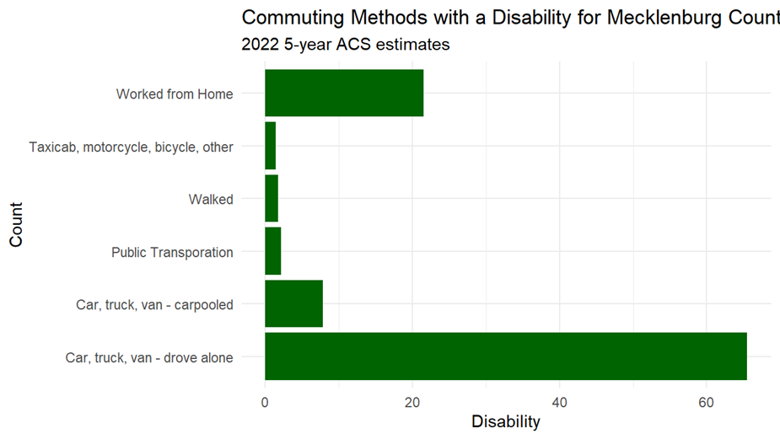
Commuting methods of disabled

Slide 18
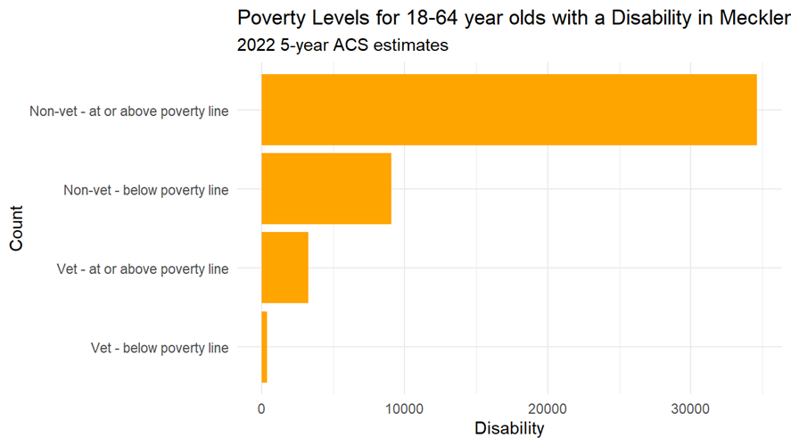
Poverty levels of disabled

Slide 19


Glance into Upward mobility

Slide 20
Adding a reality is split into steps – upward mobility
Research Area
Find & Analyze data to support
Perform data modeling
Choose 4 most salient data points
Create graphs

Slide 21

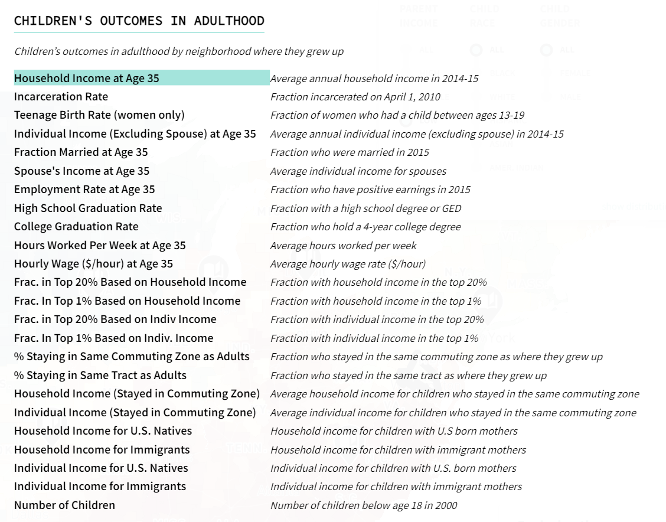
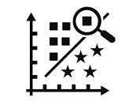
Household Income
Employment Rate
Incarceration Rate
Teen Birthrate
Educational Attainment
K-Means
Clustering Model

Slide 22
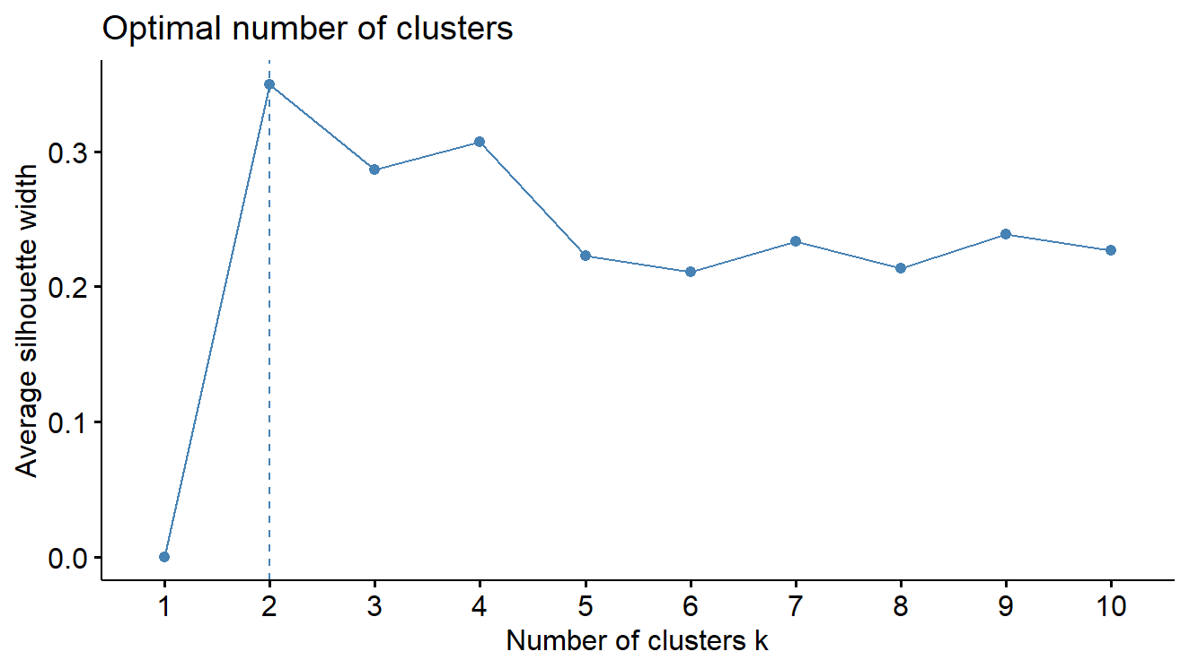
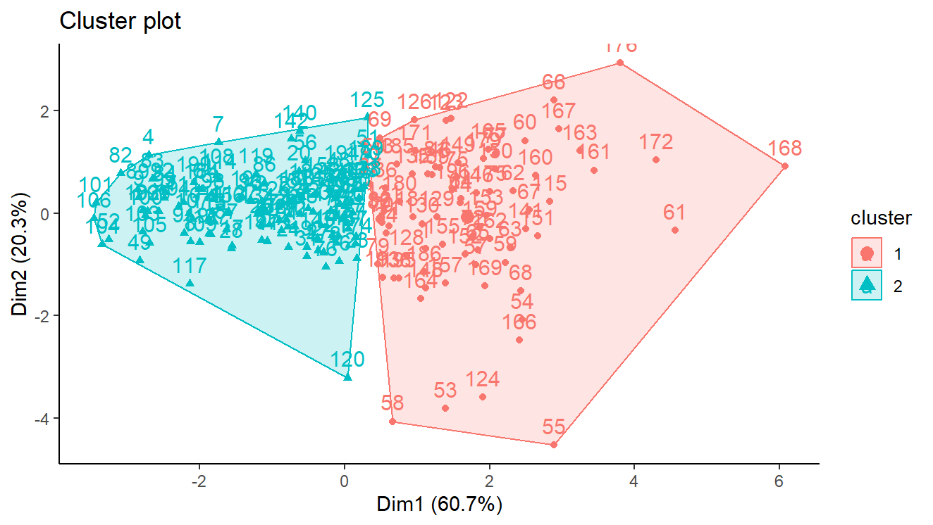
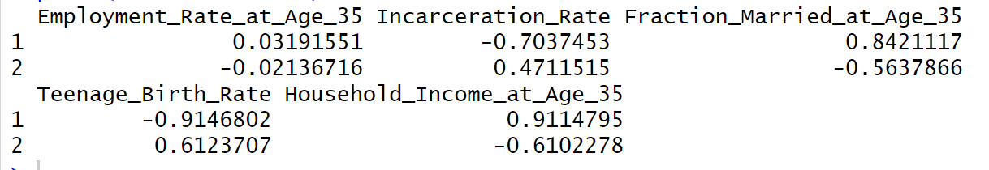
Model grouped upwardly mobile

Slide 23

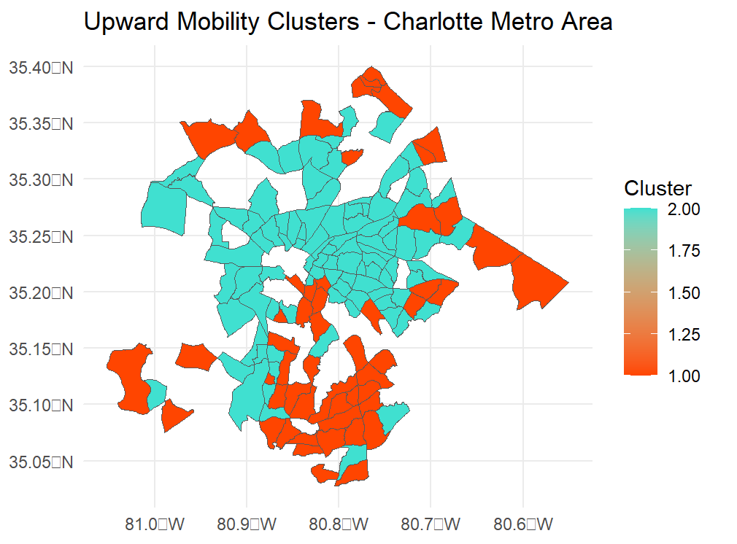
Mapping upward mobility

Slide 24


Household Income
Employment Rate
Teen Birthrate
Educational Attainment
K-Means
Clustering Model

Slide 25
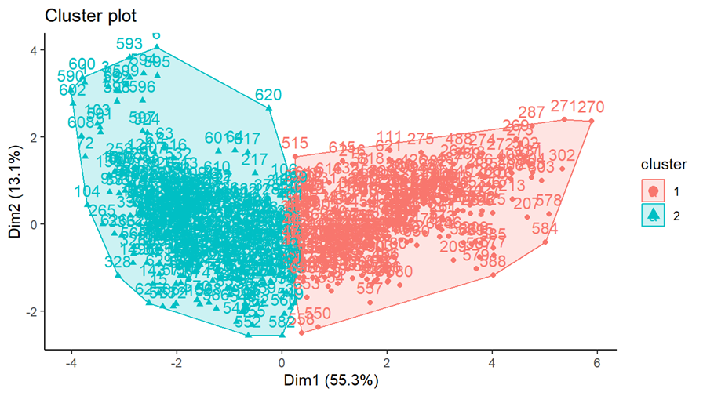
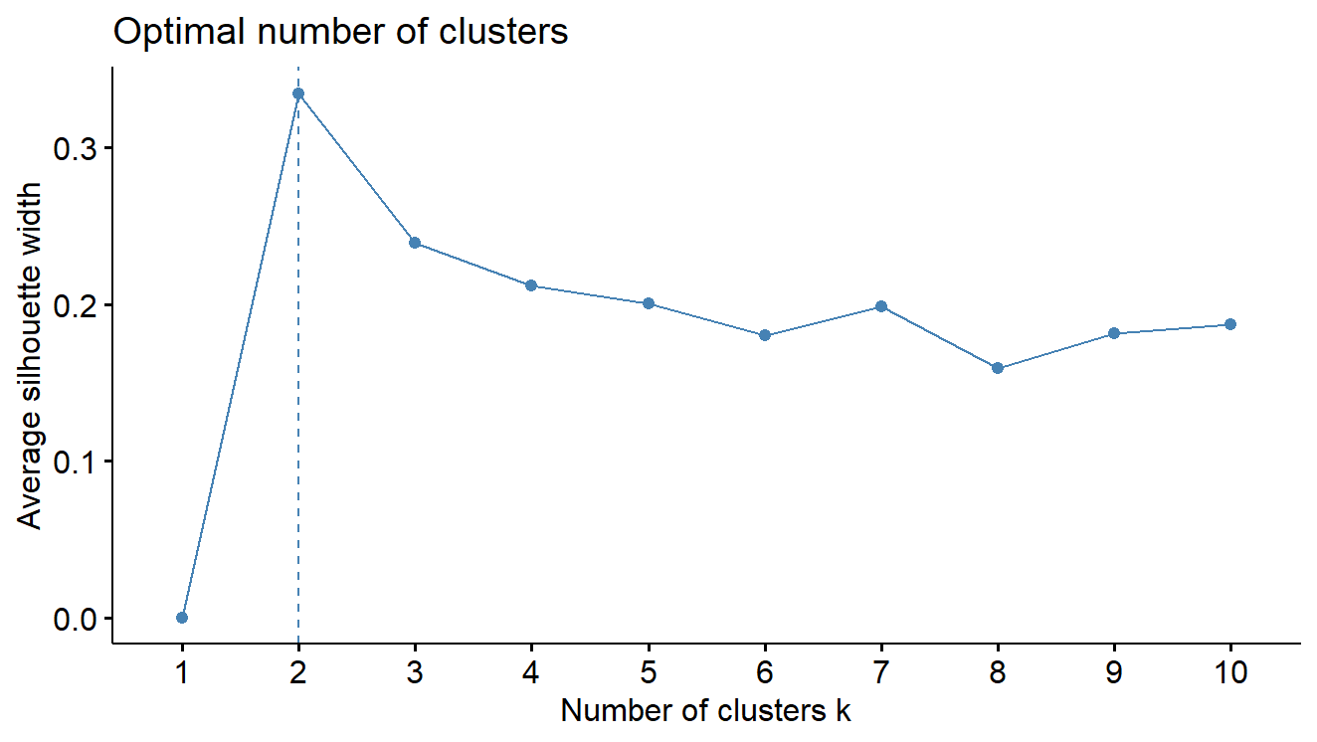
Model grouped upwardly mobile

Slide 26
Model grouping characteristics
Cluster 1 -> Tend toward Upward Mobility | Cluster 2 -> Do NOT tend toward Upward Mobility
Higher income | Lower income
Higher employment rate | Lower employment rate
Lower teen birthrate | Higher teen birth rate
Less with less than a high school education | More with less than a high school education
Less with a high school diploma or GED only | More with a high school diploma or GED only
Less with only some college | More with only some college
Many with a bachelor’s degree | Less with a bachelor’s degree
More with a master’s or professional degree | Less with a master’s or professional degree

Slide 27

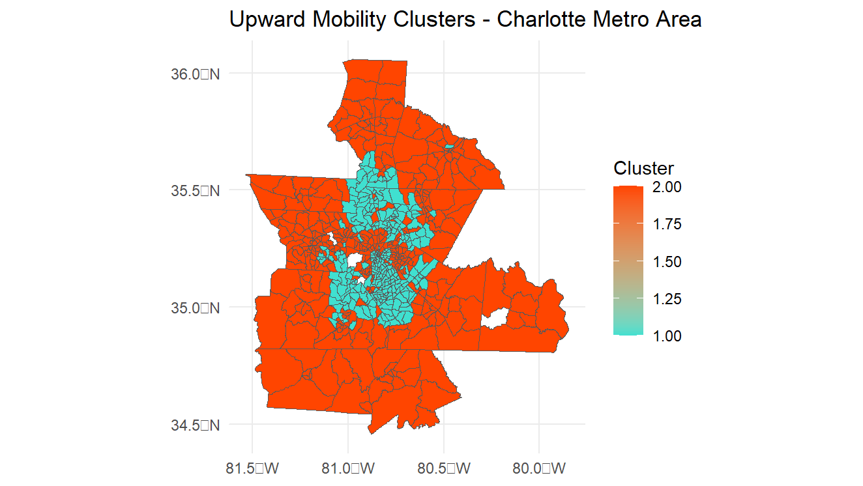
Mapping upward mobility

Slide 28
Glance at Upward mobility
Household Income
Employment Rate
Teen Birthrate
Educational Attainment

Slide 29
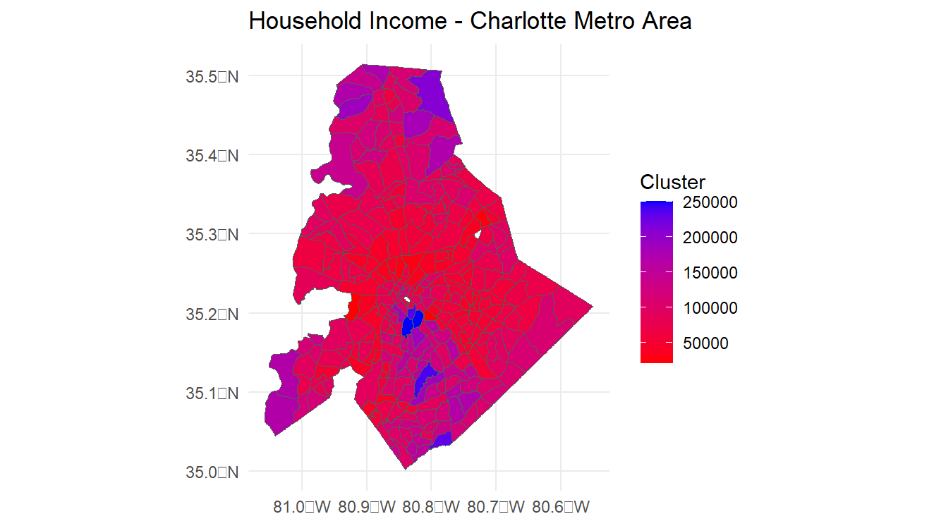

Slide 30
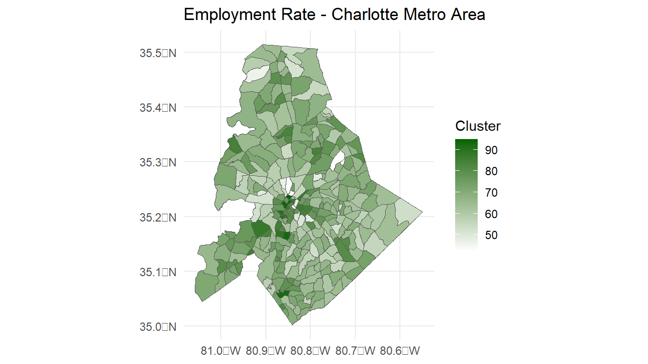

Slide 31
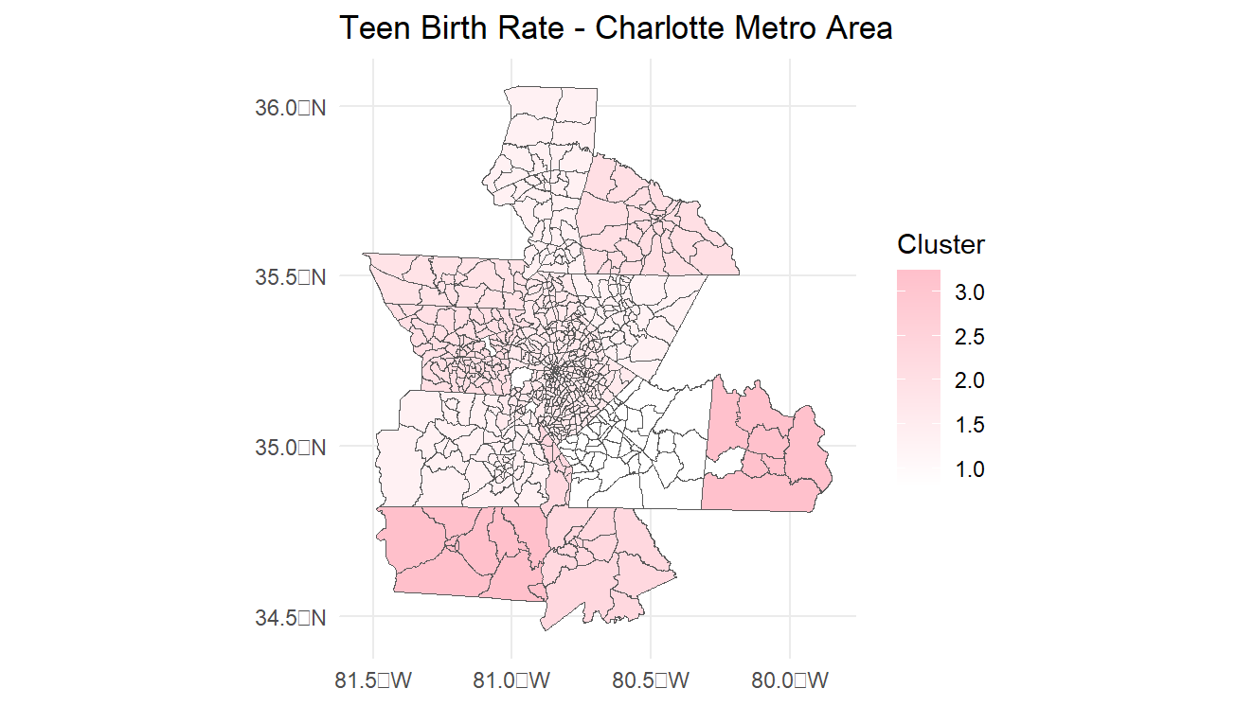

Slide 32

THANK YOU
Questions?

